Slide 1
NBN Co
Half-Year Results ‘19

Slide 2
Headline half-year results
Total revenue
Active premises
ARPU
$1,301m
4,666,965
$45
Dec 2017 : $891m
Dec 2017 : 3,386,360
Dec 2017 : $44
46%
38%
Premises ready for service
Premises ready to connect
Cash funding
9,540,584
8,099,865
$38.7bn
Dec 2017 : 7,143,268
Dec 2017 : 6,137,272
Dec 2017 : $31.1bn
34%
32%
24%
© 2019 NBN Co Ltd.

Slide 3
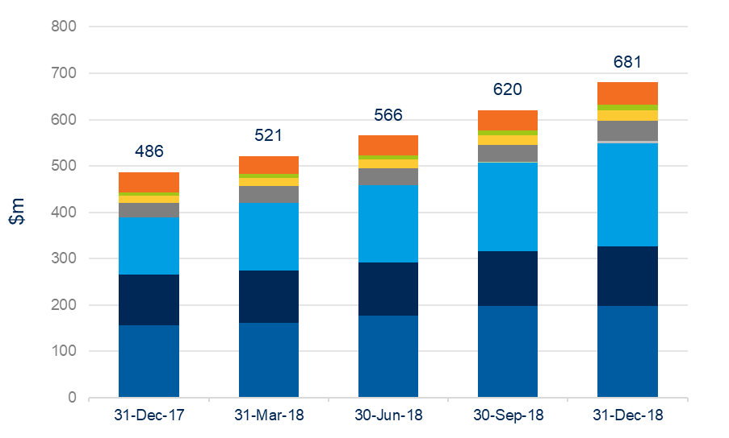
Total revenue
 | $m | 6 months to
 |  | 31-Dec-17 | 31-Dec-18
 | Other | 78 | 93
 | Satellite | 13 | 22
 | Fixed Wireless | 33 | 44
 | HFC | 50 | 79
 | FTTC | _ | 8
 | FTTN | 222 | 414
 | FTTP | 216 | 246
 | CVC/NNI | 279 | 395
 | Total | 891 | 1,301
© 2019 NBN Co Ltd.

Slide 4
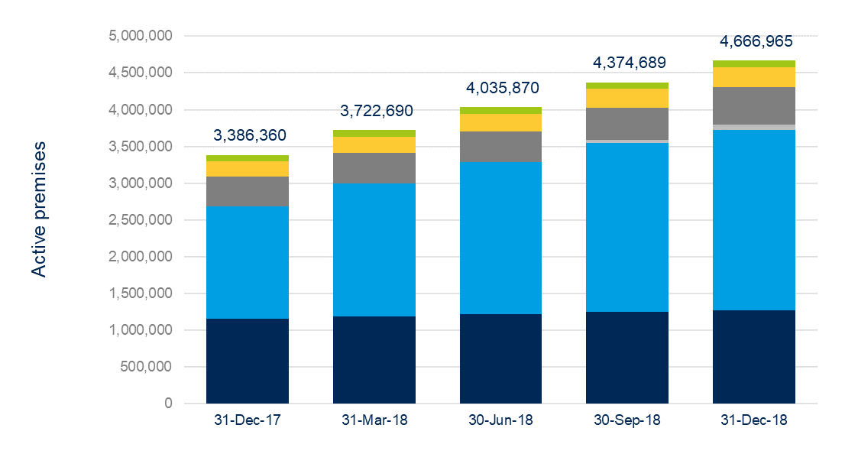
Active premises
 | Cumulative active premises | As at
 |  | 31-Dec-17 | 30-Jun-18 | 31-Dec-18
 | Satellite | 83,400 | 90,327 | 94,014
 | Fixed Wireless | 212,917 | 240,084 | 264,530
 | HFC | 408,293 | 414,703 | 511,832
 | FTTC | - | 3,977 | 76,149
 | FTTN | 1,529,907 | 2,072,451 | 2,451,706
 | FTTP | 1,151,843 | 1,214,328 | 1,268,734
 | Total | 3,386,360 | 4,035,870 | 4,666,965
 | ARPU | $44 | $44 | $45
© 2019 NBN Co Ltd.

Slide 5
Wholesale speed tiers
Fixed Line wholesale speed tiers
 | As at |  | 31-Dec-17 | 30-Jun-18 | 31-Dec-18
 | Fixed Line speed tiers (Mbps)
 | 12/1 |  | 30% | 29% | 25%
 | 25/5 |  | 52% | 22% | 17%
 | 25/10 |  | 1% | 1% | 0%
 | 50/20 |  | 4% | 37% | 49%
 | 100/40 |  | 13% | 11% | 9%
 | Total |  | 100% | 100% | 100%
 | Fixed Wireless speed tiers (Mbps)
 | 12/1 |  | 17% | 17% | 16%
 | 25/5 |  | 76% | 74% | 34%
 | 50/20 |  | 7% | 9% | 50%
 | Total |  | 100% | 100% | 100%
Sky MusterTM Satellite Service speed tiers (Mbps)
 | 12/1 |  | 33% | 32% | 31%
 | 25/5 |  | 67% | 68% | 69%
 | Total |  | 100% | 100% | 100%
Total nbnTM network speed tiers (Mbps)
Below 50/20 |  |  | 84% | 55% | 44%
50/20 or above |  |  | 16% | 45% | 56%
 | Total |  | 100% | 100% | 100%
Fixed Wireless wholesale speed tiers
© 2019 NBN Co Ltd.

Slide 6
Premises ready to connect
 | Cumulative premises ready to connect | As at
 |  | 31-Dec-17 | 30-Jun-18 | 31-Dec-18
 | Satellite | 424,184 | 430,449 | 436,580
 | Fixed Wireless | 565,557 | 609,913 | 632,733
 | HFC | 442,419 | 498,333 | 1,095,351
 | FTTC | - | 75,387 | 260,189
 | FTTN | 3,114,076 | 3,753,616 | 3,935,096
 | FTTP | 1,591,036 | 1,669,140 | 1,739,916
 | Total | 6,137,272 | 7,036,838 | 8,099,865
© 2019 NBN Co Ltd.

Slide 7
Capital expenditure
 | $m | 6 months to
 |  | 31-Dec-17 | 31-Dec-18
 | Common Capex | 318 | 279
 | Satellite | 45 | 43
 | Fixed Wireless | 159 | 204
 | HFC | 746 | 836
 | FTTC | 266 | 674
 | FTTN | 883 | 564
 | Transit | 245 | 115
 | FTTP | 175 | 193
 | Total | 2,837 | 2,908
© 2019 NBN Co Ltd.

Slide 8
Cost per premises
 | $ | Life-to-date
 |  | 31-Dec-17 | 30-Jun-18 | 31-Dec-18
 | FTTP Brownfields | 4,392 | 4,401 | 4,403
 | FTTP Greenfields | 2,264 | 2,255 | 2,209
 | FTTN | 2,222 | 2,244 | 2,259
 | FTTC | n/r | n/r | 3,058
 | HFC | 2,403 | 2,412 | 2,466
 | Fixed Wireless | 3,645 | 3,757 | 3,800
© 2019 NBN Co Ltd.

Slide 9
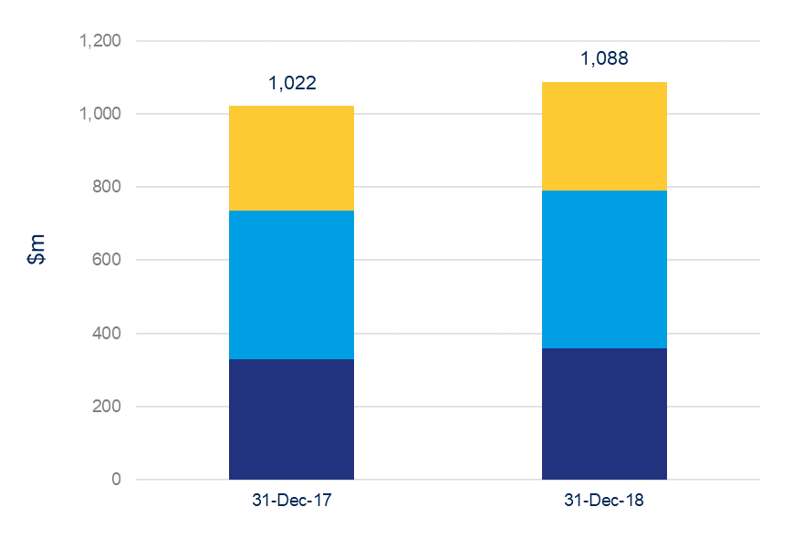
Operating expenses
 | $m | 6 months to
 |  | 31-Dec-17 | 31-Dec-18
 | Direct network costs | 329 | 359
 | Employee benefits expenses | 406 | 430
 | Other expenses | 287 | 299
 | Operating expenses | 1,022 | 1,088
 | Subscriber costs | 1,246 | 690
 | Total | 2,268 | 1,778
© 2019 NBN Co Ltd.

Slide 10
Financial summary
$m | For the 6 months ended
 | 31-Dec-17 | 31-Dec-18 | Movement (%)
Total revenue | 891 | 1,301 | 46%
Operating expenses | (1,022) | (1,088) | 6%
EBITDA before subscriber costs | (131) | 213 | 262%
Subscriber costs | (1,246) | (690) | (45%)
EBITDA | (1,377) | (477) | 65%
Depreciation and amortisation expense | (1,028) | (1,240) | 21%
Other income | 8 | 11 | 37%
EBIT | (2,397) | (1,706) | 29%
$m | As at
 | 30 Jun 18 | 31 Dec 18 | Movement (%)
Total assets | 28,203 | 30,648 | 9%
Contributed equity | 29,500 | 29,500 | 0%
Borrowings | 5,531 | 9,228 | 67%
© 2019 NBN Co Ltd.

Slide 11
Customer experience metrics
 | Year on year on performance |  | Today’s report
 | December 2017 | December 2018 | January 2019
Ready to connect | 6.1 m | 8.1 m | 8.3 m
Connected homes and businesses | 3.4 m | 4.7 m | 4.8 m
Installed right the first time | 86% | 93% | 91%
Meeting agreed installation times | 94% | 93% | 87%
Average network bandwidth congestion | 1 hr 30 mins | 40 mins | 45 mins
Fixed Line network congestion | 0.097% | 0.022% | 0.018%
Fixed Wireless busy hour network performance |  | 96.6% | 95.6%
Uptake to higher wholesale plans | 16% | 56% | 57%
Network availability | 99.9% | 99.9% | 99.9%
Meeting agreed fault restoration times | 82% | 91% | 86%
Faults per 100 connected homes and business | 1.0 | 0.8 | 0.9
Please see the important explanation of the metrics on our website
https://www1.nbnco.com.au/corporate-information/about-nbn-co/updates/dashboard-december
© 2019 NBN Co Ltd.

Slide 12
Customer experience commitment
Connect
Use
Fix
© 2019 NBN Co Ltd.

Slide 13
FY19 Outlook
On track to complete build by 2020
On track for more than $5 billion revenue by FY22
Building a strong business model for the future
Enabling social and economic benefits
© 2019 NBN Co Ltd.

Slide 14
This presentation contains some information extracted from the Half-Year Financial Report of NBN Co Limited (NBN Co) for the period ended 31 December 2018. The Half-Year Financial Report consists of the Statement of profit or loss and other comprehensive income, Statement of financial position, Statement of changes in equity and Statement of cash flows for the NBN Co Group comprising NBN Co limited, NBN Co Tasmania Limited and NBN Co Spectrum Pty Ltd. While every effort is made to provide accurate and complete information in this presentation, no representation or warranty is made as to the accuracy or completeness or reliability of that information.
All amounts are in Australian Dollars unless otherwise stated.
This presentation may contain forward looking statements that are based on NBN Co's best considered professional assessment of present economic and operating conditions, present Australian Government policy and a number of assumptions regarding future events and actions which, at the date of this presentation, are expected to take place. Such forward looking statements are not guarantees of future performance and involve known and unknown risks, uncertainties, assumptions and other important factors, many of which are beyond NBN Co's control.
While such forward looking statements are based on NBN Co's best considered professional assessment, NBN Co's officers do not give any assurance to any third party that the results, performance or achievements expressed or implied by such forward looking statements will actually occur and such statements should not be relied on or considered to be a representation of what will happen by any third party.
Other than as required by NBN Co's reporting obligations to the Commonwealth, NBN Co and its officers have no obligation to update these forward looking statements based on circumstances, developments or events occurring after the date of this presentation.

